Slide 1
Automatic Ticketing System (ATS)
Group: SenseIT
Intelligent Buildings
Junction 2016

Slide 2
Opportunity
Running out of daily office supplies.
Oblivious maintenance tasks.
Human resource waste on tedious tasks.
Floor inspection.
Assign repetitive activities.
Signing inspection papers.

Slide 3
Solution
Ticketing System.
Detect Problem: Failure / lack of supplies.
Sensors.
Find suitable resource to fix problem.
Location
Role
Generate and Assign ticket.
Fix problem.
Close ticket.

Slide 4
Solution Architecture
ATS
Database

Slide 5
Frontend - Manager

Slide 6
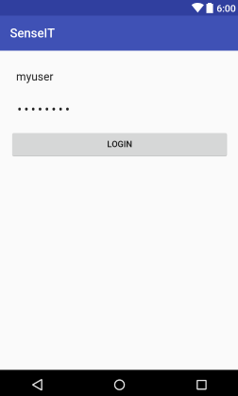
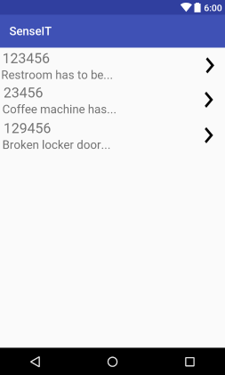
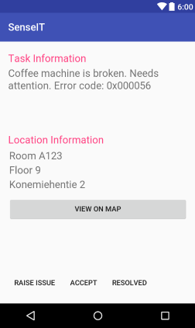
Frontend - Worker

Slide 7
Backend

Slide 8
Bounty
Improve response time.
Automate Maintenance Processes.
Efficient Resource Utilization.
Reducing costs on HR.
Accountability.

